Slide 1
Strategic Management Case 2
Customer segmentation
Analysis prepared for DABN17 Analytics-based Strategic Management
Bakary Bah Isak Skaghammar Jan Jarco Lennart Wunderlich Sebastian Brugger

Slide 2




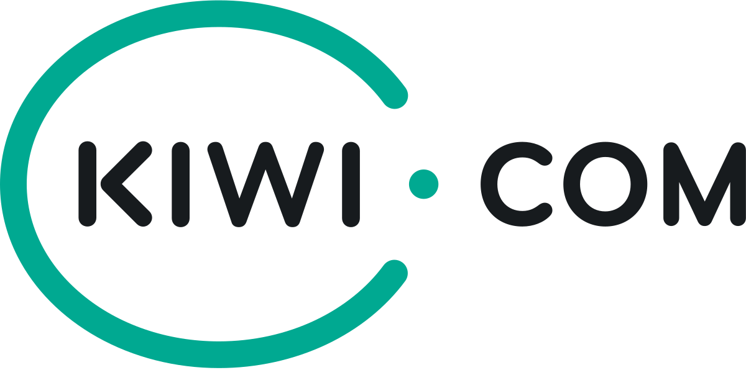
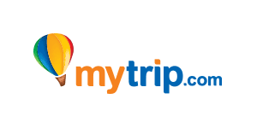




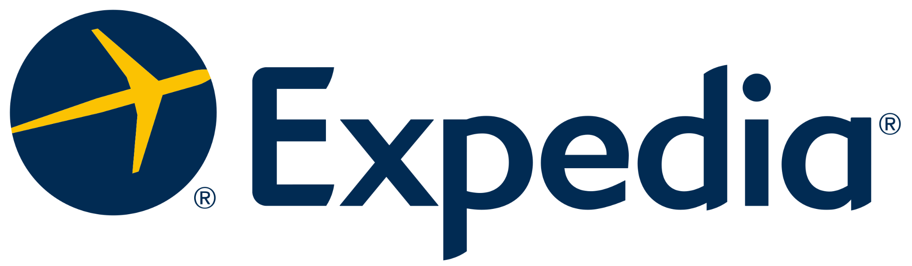

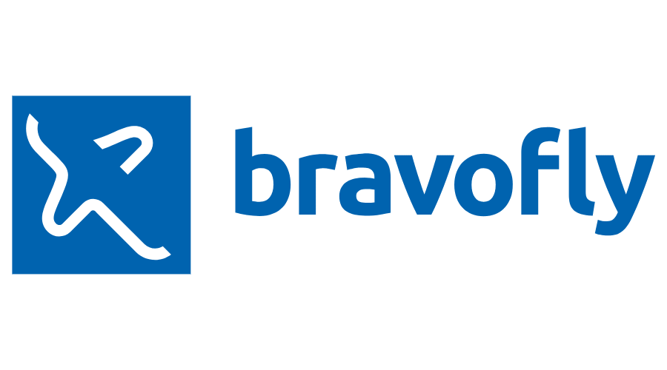

Challenges to Travel Agency
Customer knowledge
Unused data
Competition
Notes:
AOB Travel sits on large amounts of order and search data but they haven’t make use of it yet
So far: address current buying trends to optimize supply and offer prices
→ good at adjusting to purchasing trends but assume limited customer knowledge
Tight market conditions characterized by large competition and small margins:
AOB Travel needs to act creative and unique to stay competitive
Our solution to tackle all three challenges:
Use raw data for clustering machine learning techniques to gain knowledge about customer segments
Help AOB Travels flight ticket platforms to find customer tailored unique solutions and strengthen competitive position

Slide 3
Agenda
Industry Analysis
Clustering
Results
Conclusion

Slide 4
Industry Analysis: Porter’s Five Forces
Internal Rivalry
Though competition on market
05
Bargaining Power Suppliers
Very high (pricing power)
01
04
Bargaining Power Buyers
Very high (low switching costs)
Market Entry
Moderate threat of new entries
02
03
Substitutes and Complements
Moderate but increasing threats from substitute products
Notes:
To figure out what AOB Travel should focus on most, we did a market analysis with the help of porter's five forces. By doing this we concluded that:
There is a tough competition in their market (as mentioned before)
New market entries relatively easy but tight market already and brand recognition and relationships with airlines could take time to build up → moderate threat
Alternative transportation like trains which could compete on shorter distances
Could argue that due to climate change this could be a threat if customer wants to chose green options
Especially on middle-longer distances no specific threat in short-to middle term
The power of customer is very high:
Price information through meta-search sites
Low switching costs for consumers (also mainly due to meta-sites)
The supplier (airlines) also very high:
Hold airline tickets and set prices on online platforms
Can choose flight booking platforms to cooperate with (if they want to launch campaigns)
With our approach provide suggestions on how to tackle last two forces and improve competitive position → First: let’s have a look at the method

Slide 5



What customer segments can we identify?

Slide 6
Only 8% of clicks resulted in orders on the site
Clicks
- 92%
Orders
- 1%
Missing price information
-5%
Used data
186.6 K
14.4 K
14.3 K
13.6 K
Can we figure out, who is flying with this travel agency?
Notes:
⎬

Slide 7




Our customer segmentation algorithm
Method: K-means clustering
Data: The properties we chose
Sales price
Scientific-proven method
Segmenting observations for several groups with similar properties
Travel time
Travel distance
Notes:
I added an animation @se

Slide 8
Our customer segmentation algorithm
Method: K-means clustering
Data: The properties we chose
Sales price
Scientific-proven method
Segmenting observations for several groups with similar properties
Travel time
Travel distance
Notes:
I added an animation @se

Slide 9
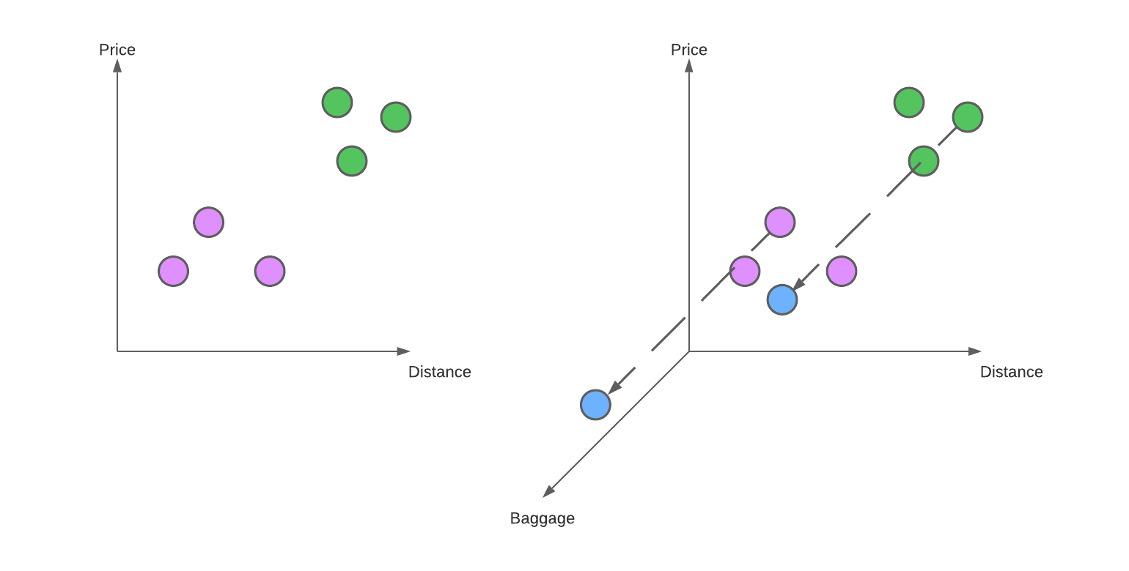
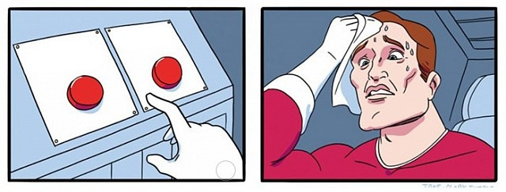
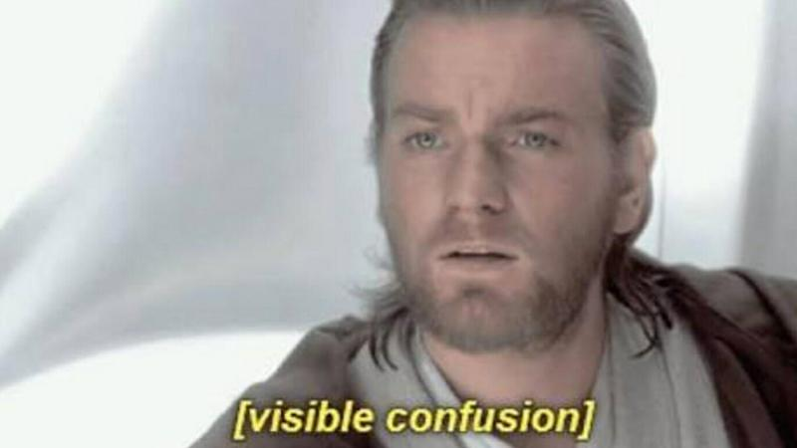
Challenges of a good K-means algorithm
Multidimensionality of K-means
4th dimension: # adults
Interpretability
Notes:
I added an animation @se

Slide 10
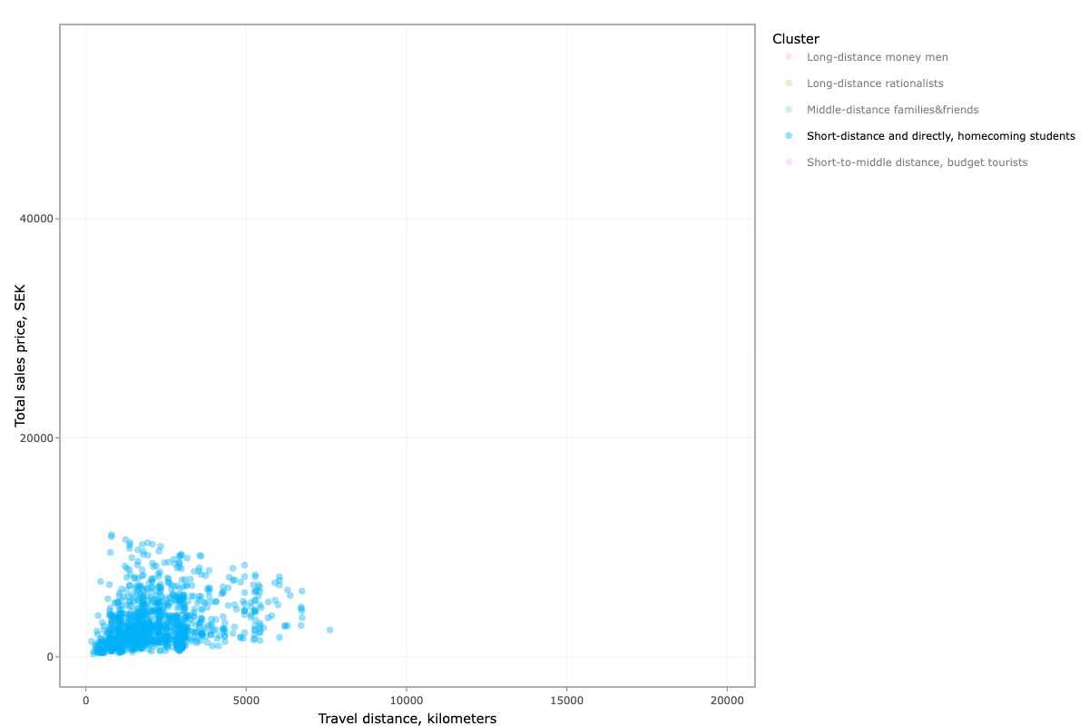
What segments can we identify?
Short-distance and directly, homecoming students

Slide 11
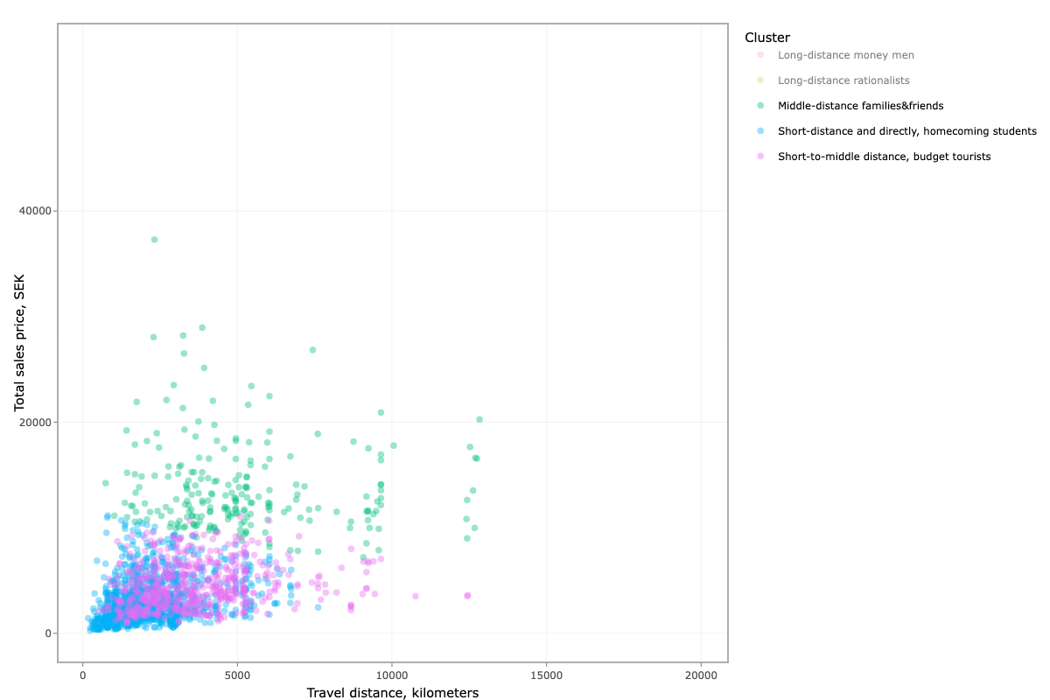
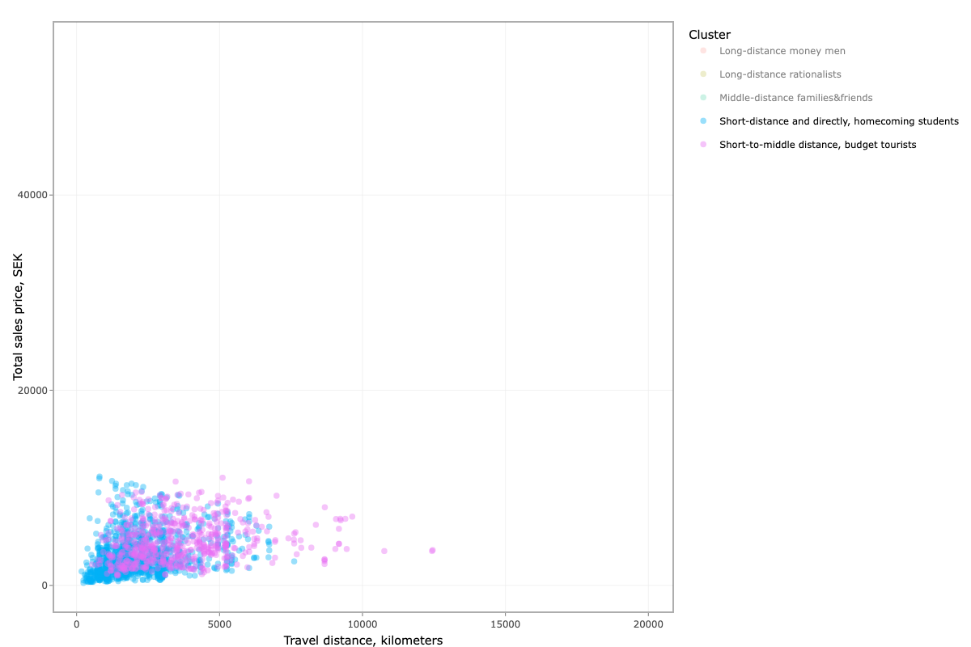
What segments can we identify?
Short-distance and directly, homecoming students
Short-to-middle distance, budget tourists

Slide 12
What segments can we identify?
Short-distance and directly, homecoming students
Short-to-middle distance, budget tourists
Short-to-middle distance, family & friends

Slide 13
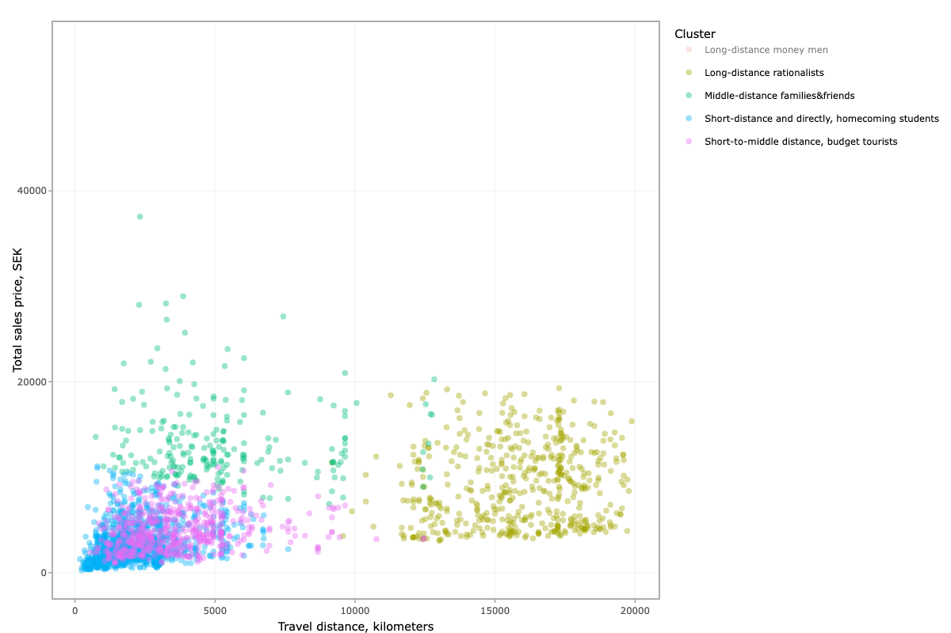
What segments can we identify?
Short-distance and directly, homecoming students
Short-to-middle distance, budget tourists
Short-to-middle distance, family & friends
Long-distance rationalists

Slide 14
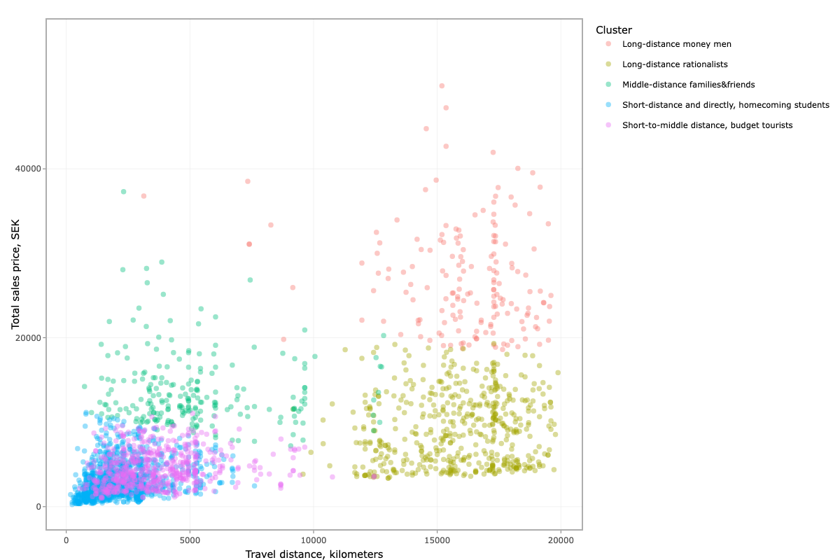
What segments can we identify?
Short-distance and directly, homecoming students
Short-to-middle distance, budget tourists
Short-to-middle distance, family & friends
Long-distance rationalists
Long-distance money men

Slide 15
Characteristics of the segments

Slide 16
Main characteristics used for clustering
Metric | Short-distance and directly, homecoming students | Short-to-middle distance, budget tourists | Middle-distance families & friends | Long-distance rationalists | Long-distance money men
Number of bookings | 5 986 | 2 952 | 1 089 | 2 642 | 942
Average sales price | 2 949 kr | 4 565 kr | 13 987 kr | 9 546 kr | 27 855 kr
Average total travel distance | 2 201 km | 3 628 km | 5 182 km | 15 819 km | 16 162 km
Average travel time | 4h 04min | 11h 10min | 11h 00min | 30h 07min | 32h 46min
Notes:
Number of bookings: the biggest group that we extracted from the data is a segment of customers that picked short-distance and mostly direct flights
The group with the lowest representation is long-distance money-men that should be a focus for AOB travel as they probably gain the most money with service for these customers what will be proven later as well.
Average sales price - Once again the cheapest flights were ordered by homecoming students or abroad workers that come home for short time window
SImilar rule can be seen for Average total distance but as well Long distance rationalists’ total distance is similar for both long distance segments

Slide 17
What kind of routes do they choose?
Metric | Short-distance and directly, homecoming students | Short-to-middle distance, budget tourists | Middle-distance families & friends | Long-distance rationalists | Long-distance money men
Number of bookings | 5 986 | 2 952 | 1 089 | 2 642 | 942
Bookings per destination | 5.12 | 2.06 | 1.95 | 2.06 | 1.59
Share of direct flights | 94% | 3% | 42% | 5% | 2%
Average price per kilometer | 0.86 kr | 0.77 kr | 0.84 kr | 0.42 kr | 0.66 kr
Notes:
Number of bookings: For presenting reasons I kept as well this number of orders in particular segments
Booking per destination - This ratio shows average number of booking of the same route in the segment. This metric can capture in very simplified sense the diversity of chosen routes by the customers. The most repeatable and predictable can be the first group of short distance direct flights
However other groups maintain similar level of diversity in routes, while long distance money men choose the most versatile and probably exotic destinations
Share of direct flights - These numbers capture the share of customers that ordered direct flights versus these with stops in the middle to the destination. There is a huge difference between short-range flights and long distance ones. As AOB Travel charge additionally for setting more complicated routes with several stops they cannot take that high advantage from short-distance and direct flights versus long distance trips
Average price per km - This measure is very interesting that the highest is charged for short-distance travelers while the lowest can be observed for Long distance rationalists making this group the least profitable for AOB.

Slide 18
How many passengers? Luggage or not?
Metric | Short-distance and directly, homecoming students | Short-to-middle distance, budget tourists | Middle-distance families & friends | Long-distance rationalists | Long-distance money men
Number of bookings | 5 986 | 2 952 | 1 089 | 2 642 | 942
Average no. adults | 1.55 | 1.63 | 3.22 | 1.45 | 2.62
Average no. children | 0.21 | 0.12 | 0.50 | 0.08 | 0.44
Share of orders with luggage | 8% | 17% | 31% | 33% | 62%
Notes:
Now, let’s take a look at thes structure of orders in terms of passengers and then luggage as well
Average no. adults - THe highest is for short-to-middle distance, budget tourists and it oscillates above 3 on average while the lowest was found for long-distance rationalist
Average no. children - Potentially number of children is favourible for AOB Travel as cancellations are more probable for orders with children. These rebookings for budget tourist and money men can make AOB more profitable. ALso this group is more vulnerable to buy additional insurance which is the next source of profit for AOB, so it’s important for AOB to consider
On the other hand we have share of orders with luggage which is the highest for money men and the lowest for short distance, direct travelers.
Okay I think this summary described in detail our segments and their characteristics with early mentioned implications for AOB Travel business. We still need to consider profit margin on these criteria like multi-stop travelling, cancellations, luggage and other add-ons to decide how to approach our groups of customers.

Slide 19


Analysis: tying things together
Customer focus:
Increase revenue
Decrease costs
Supplier focus:
Improve relationship with airlines
Notes:
We have now shown you our customer segmentation and our industry analysis. So have could this be used by AOB Travel? As we mentioned earlier we will use two out of Porter's five forces, bargaining power of the customer and the bargaining power of the suppliers in this case.
Firstly, the bargaining power of the customer might not be affected by our segmentation analysis, but when they have a better picture of the customer they can control the environment they are working within. So by knowing their customers and they can focus on the most profitable ones and also reduce their costs:
Reducing costs could be done by identifying customers who tend to book the flights and not only search for them, as you know the clicks on the meta sites is a cost for AOB Travel. So if certain types of customers tend to book certain types of routes, the route and type of customer could then be matched on the website.
They could also increase its revenue with the help of segmentation, by targeting customers willing to buy more add-ons such as extra luggage they could generate more profit.
On the other hand, AOB Travel could use the output of the model to decrease the bargaining power of the suppliers which in this case are the airlines.
Given the new customer knowledge, the negotiation power could be increased by offering them customer-tailored campaigns.
AOB Travel could offer attractive prices to customers that are desirable to get for the airlines such as families or customers likely to book many add-ons. AOB Travel could in return, get better pricing conditions when buying tickets from the airlines.

Slide 20
Further implications
More variables
Longer time period
Clusters within clusters
Notes:
At last, based on our findings we would recommend AOB Travel to dig deeper into customer segmentation. They could use more variables over longer time periods. An example could be to identify customers who are more likely to cancel and re-book, targeting these types of customers could increase their margins.
An additional suggestion to AOB Travel would be to cluster within clusters to get extra insight in the customer segments. This results in an even deeper understanding of how groups of customers behave. We did this ourselves but due to technicality we considered this to be outside of the scope for this assignment. Hope you enjoyed our presentation. Thank you!

Slide 21
Thank you!

Slide 22
References
Cui (2020), Introduction to the K-Means Clustering Algorithm Based on the Elbow Method, Clausius Scientific Press, Canada
Porter (1979), How Competitive Forces Shape Strategy, Harvard Business Review, available at: https://hbr.org/1979/03/how-competitive-forces-shape-strategy
Tan, Steinbach, Kumar (2021), Introduction to Data Mining, second edition, Pearson
Icons used in the slides taken from https://www.flaticon.com/

